Slide 1
Journey PPT -2
Daksh Malik
Batch - 7

Slide 2
Day 1
Introduction to Business analysis
Discussion of the various phases of development:
Requirement Analysis
Requirement Elicitation
Requirement Modelling
Requirement Management
Requirement Traceability
Discussion on various Software Development Models such as:
Waterfall model
Agile model
Introduction to SCRUM
ACTIVITY – To roleplay the various phases involved in SCRUM
Daily Standup
Sprint Planning
ASSIGNMENT – Requirement Traceability for given scenario

Slide 3
Day 2
Discussion on Agile methodology
SCRUM
KANBAN
Comparison between KANBAN and SCRUM
Values and principles of Agile methodology
Discussion of Document of Ready (DoR) and Document of Done (DoD)
Estimation in Agile:
Scope
Time
Cost
Various charts used:
Burndown chart
Burnup chart
Velocity chart
ACTIVITY – To roleplay the various phases involved in SCRUM
Sprint review
Sprint retrospection
ASSIGNMENT – Introduction to Azure DevOps

Slide 4
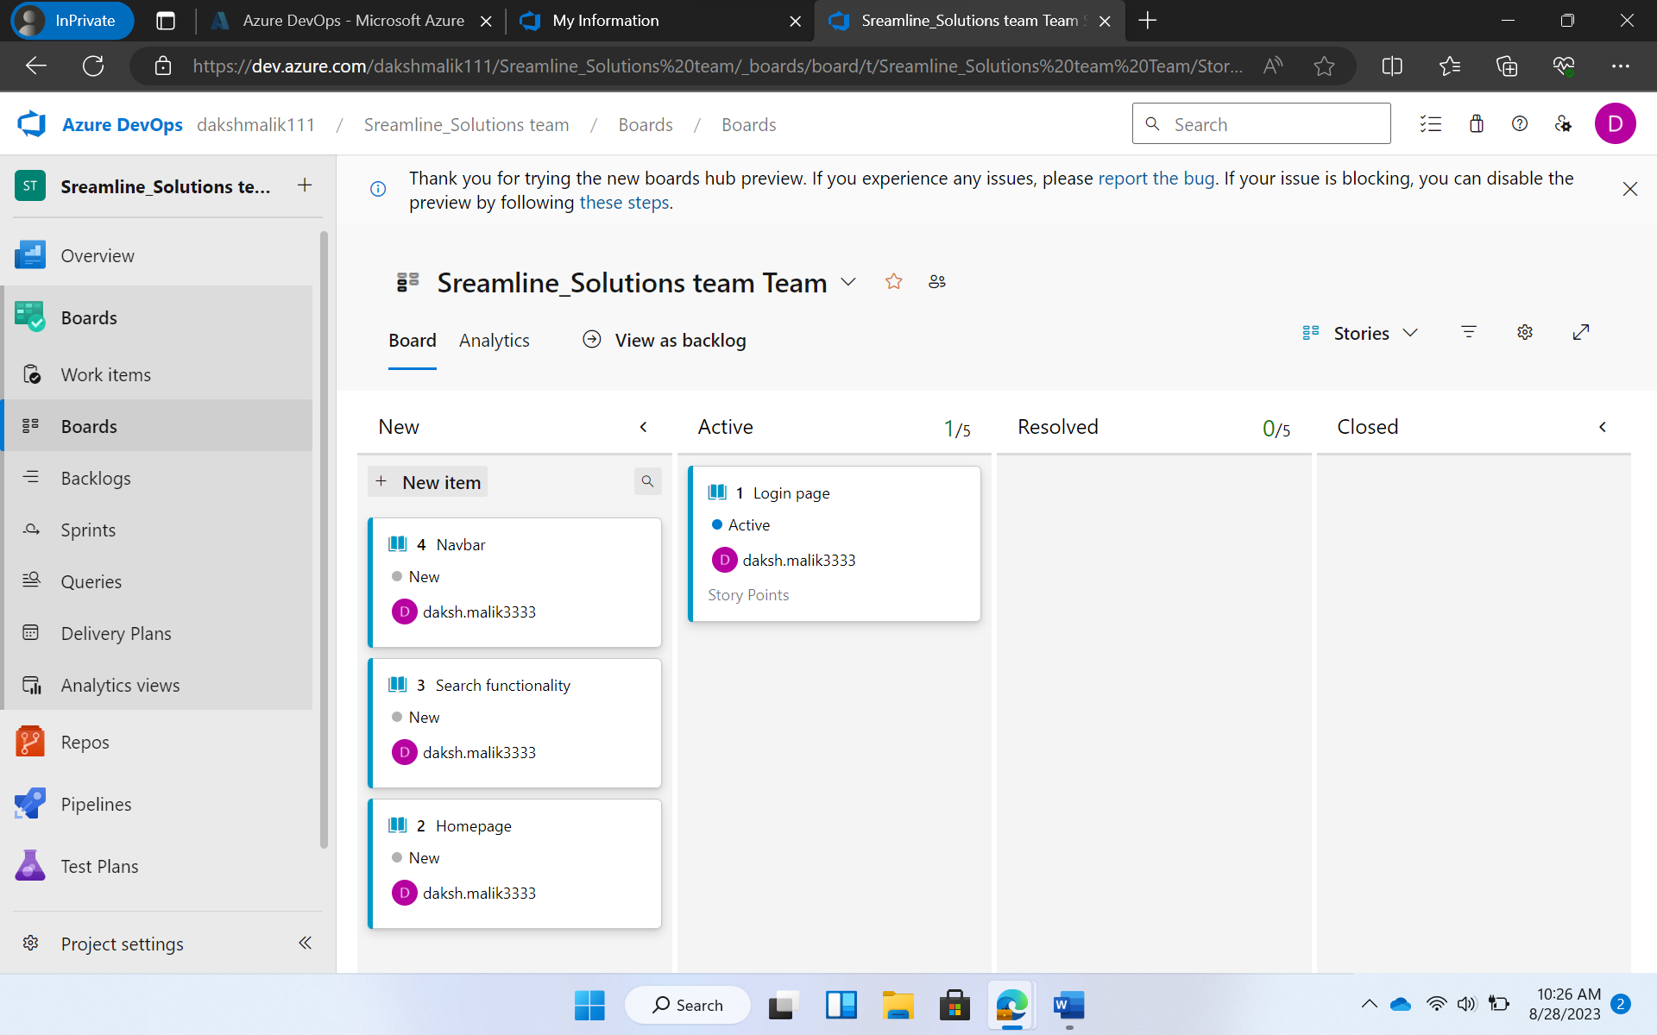
Various components of sprint: Epic, User Story, Sub Task and Test Case

Slide 5
Day 3
Brief about data and information
Introduction to database and database management system
Types of databases
Discussion about ACID property of DBMS
Introduction to the various operations of SQL – DDL, DQL, DML, DCL and TCL
Introduction to Normalization and it’s need
Discussion about:
Functions – group by, order by
Joins and its types
Aggregate functions
Sub queries
ASSIGNMENT – Hands on experience with Postgre SQL

Slide 6
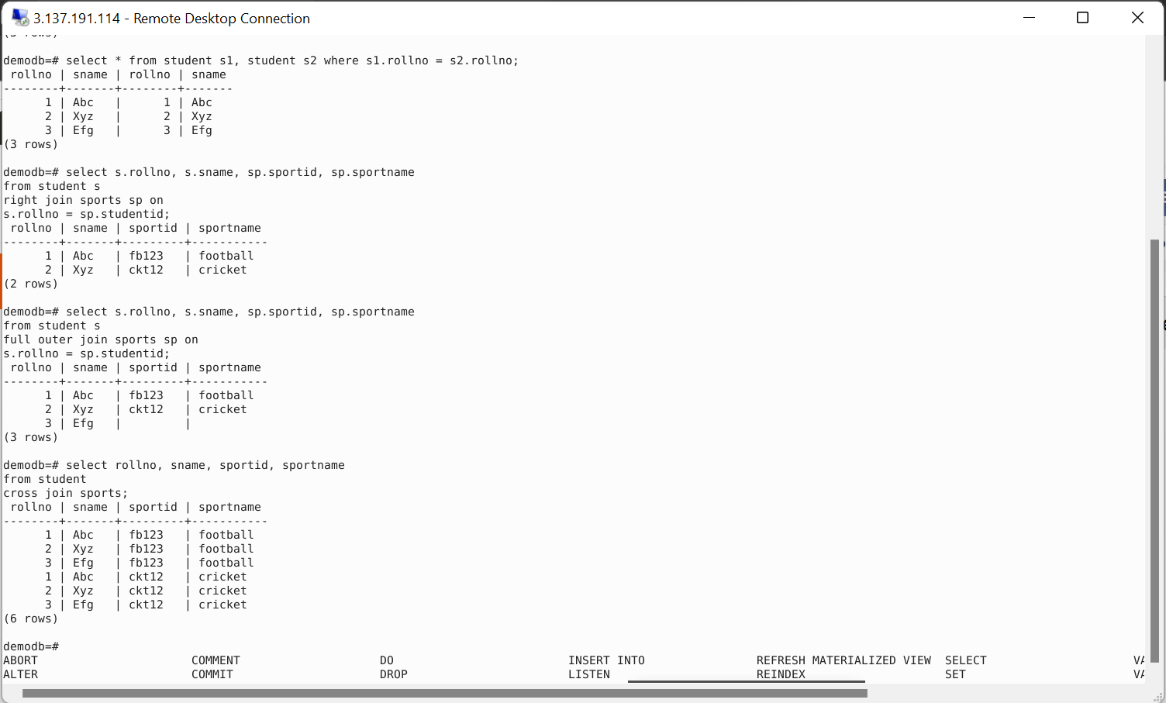

Slide 7
Day 5
Introduction to DevOps
Discussion on principles of DevOps
Discussion on DevOps lifecycle and it’s phases
Introduction to the various DevOps tools depending on the phase
Introduction to Continuous Integration and Continuous Deployment (CI/CD)
Introduction to GitHub actions
Discussion on the various components of GitHub action
Workflow
Event
Job
Action
Runner
ASSIGNMENT – To setup a GitHub action workflow

Slide 8
Day 6
Introduction to cloud computing
Discussion on various types of cloud service models
Software As A Service (SAAS)
Platform As A Service (PAAS)
Infrastructure As A Service (IAAS)
Introduction Service Layers of cloud platform
Discussion on cloud sourcing and the advantages of cloud services
Introduction cloud taxonomy and it’s divisions
Introduction to Microsoft Azure and it’s various offerings
Analytics, Computing, Networking, Storage, etc.
Discussion about the drawbacks and challenges in cloud computing
Discussion about the future of cloud computing
ASSIGNMENT – Setting up an Azure virtual machine

Slide 9
Day 7
Azure Board Activities
Azure VM Creation
Github Activities
Maven Activity
Prometheus Activity
Dockerfile Creation
Github Actions
Azure Web App Creation
Azure Web App Deployment
Testing the Output

Slide 10
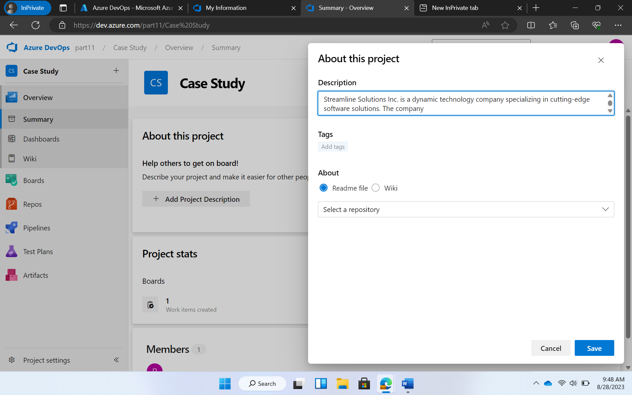
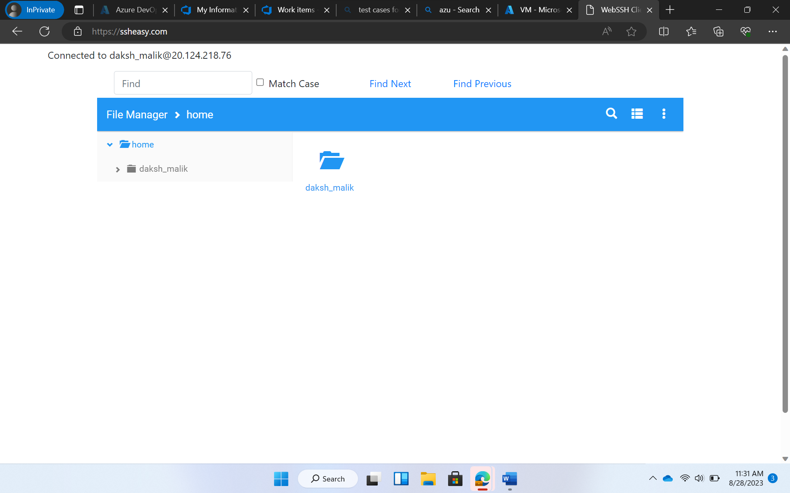

Slide 11
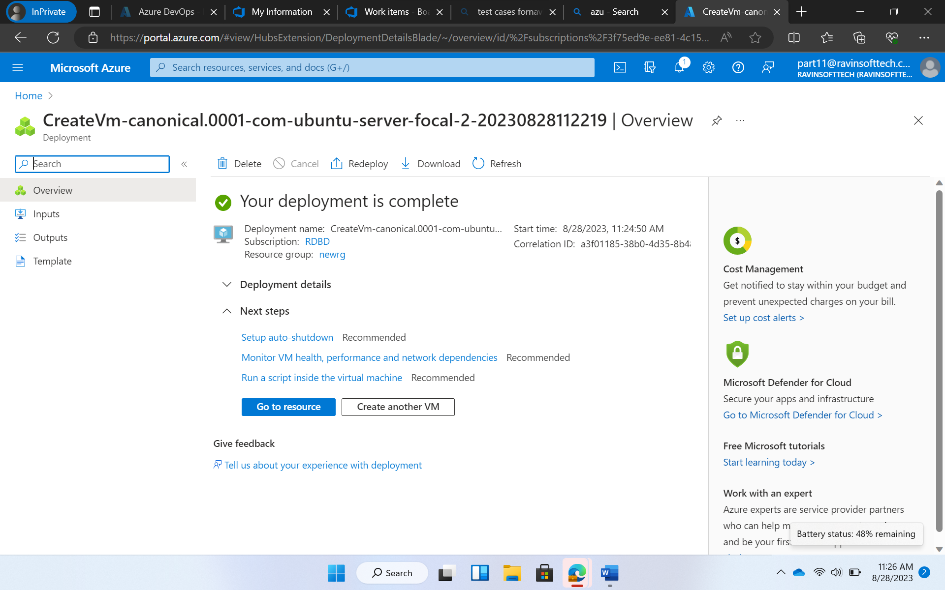

Slide 12
Day 8
Introduction to what is data
Types of data
Structured
Semi-Structured
Unstructured
Introduction to Database Management System
Entity – Relationship Diagram
Normalization
Denormalization
Case Study – Book Store Database
E-R Diagram
Normalization
Dimension Modelling
Star Schema
Snowflake Schema
Slowly Changing Dimensions and its types
SCD1
SCD2
SCD3

Slide 13
Day 9
Overview of Big Data and the 4 Vs – Volume, Variety, Velocity and Veracity
Batch and Stream Processing
Parallel Processing/ Distributive Computing
Different platforms - HADOOP and Spark
Data Warehouse
Data Lake
Data Lakehouse
Various Azure certifications
Overview of Cloud
Types of Clouds - Public, Private and Hybrid
Models of Cloud:
Infrastructure As A Structure (IAAS)
Platform As A Structure (PAAS)
Software As A Structure (SAAS)

Slide 14
Shared Responsibility Model
Serverless Computing - Azure Function and Azure Logic app
Azure Architecture:
Region
Region Pair
Availability Zones
Azure Subscription
Azure Resource Manager
Azure resources

Slide 15
Day 10
Introduction to Structured Query Language (SQL)
Schemas
Data Definition Language and its commands:
CREATE, DROP, ALTER, TRUNCATE
Data Manipulation Language and its commands:
UPDATE, DELETE, INSERT
Data Control Language and its commands:
GRANT, REVOKE
Constraints
ER Modelling
Order of Execution in SQL
Filtering query
Grouping data - using Having clause
Activity – Hands on experience with SQL queries

